Slide 1
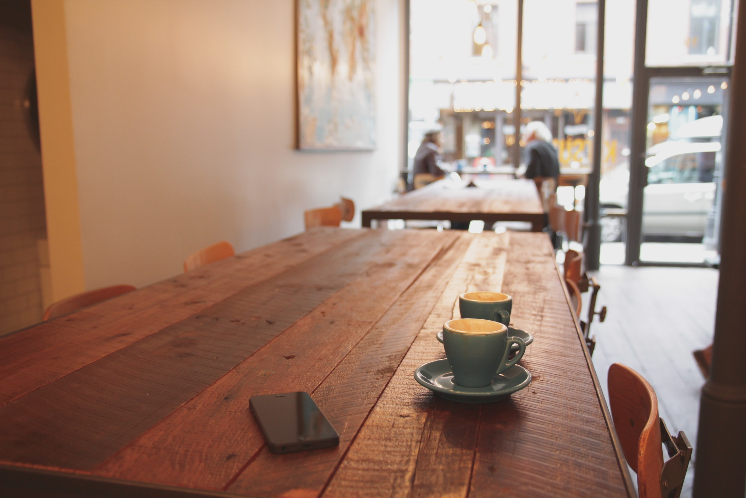
Chicago Coffee Clusters
Max Barry,
March 28th, 2019
Notes:
Hi, I’m Max Barry, and over the next several minutes I’ll explain how I used machine learning to select the best locations in Chicago to open a coffee shop.

Slide 2
I love a good coffee shop…
…and there is always room for one more.
Notes:
As you may have guessed, I love both coffee and coffee shops.
These are photos of some of my favoritesL Wormhole, Osmium, La Colombe
And although the city has A LOT OF GOOD COFFEE SHOPS, there’s always room for one more

Slide 3





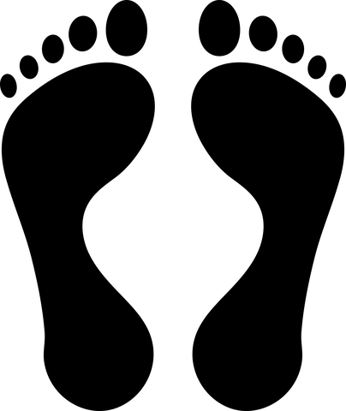



Where to start?
911
$$$
Notes:
But where do you start? Selecting a business location is COMPLICATED. Want constitutes a desirable location depends on BUSINESS PRIORITIES. For a coffeeshop, one might prioritize high foot traffic, proximity to the el, distance from competitors but proximity to other restaurants and businesses, proximity to cultural or educational institutions, libraries and bookstores, or target neighborhood demographics such high levels of single family homes, high average income, or low crime.
The point being, for openended questions like this one, there is no ONE RIGHT ANSWER, and one has to rely on domain knowledge as a guide, which in this case is my knowledge of coffeeshops and the city
Get timing down

Slide 4
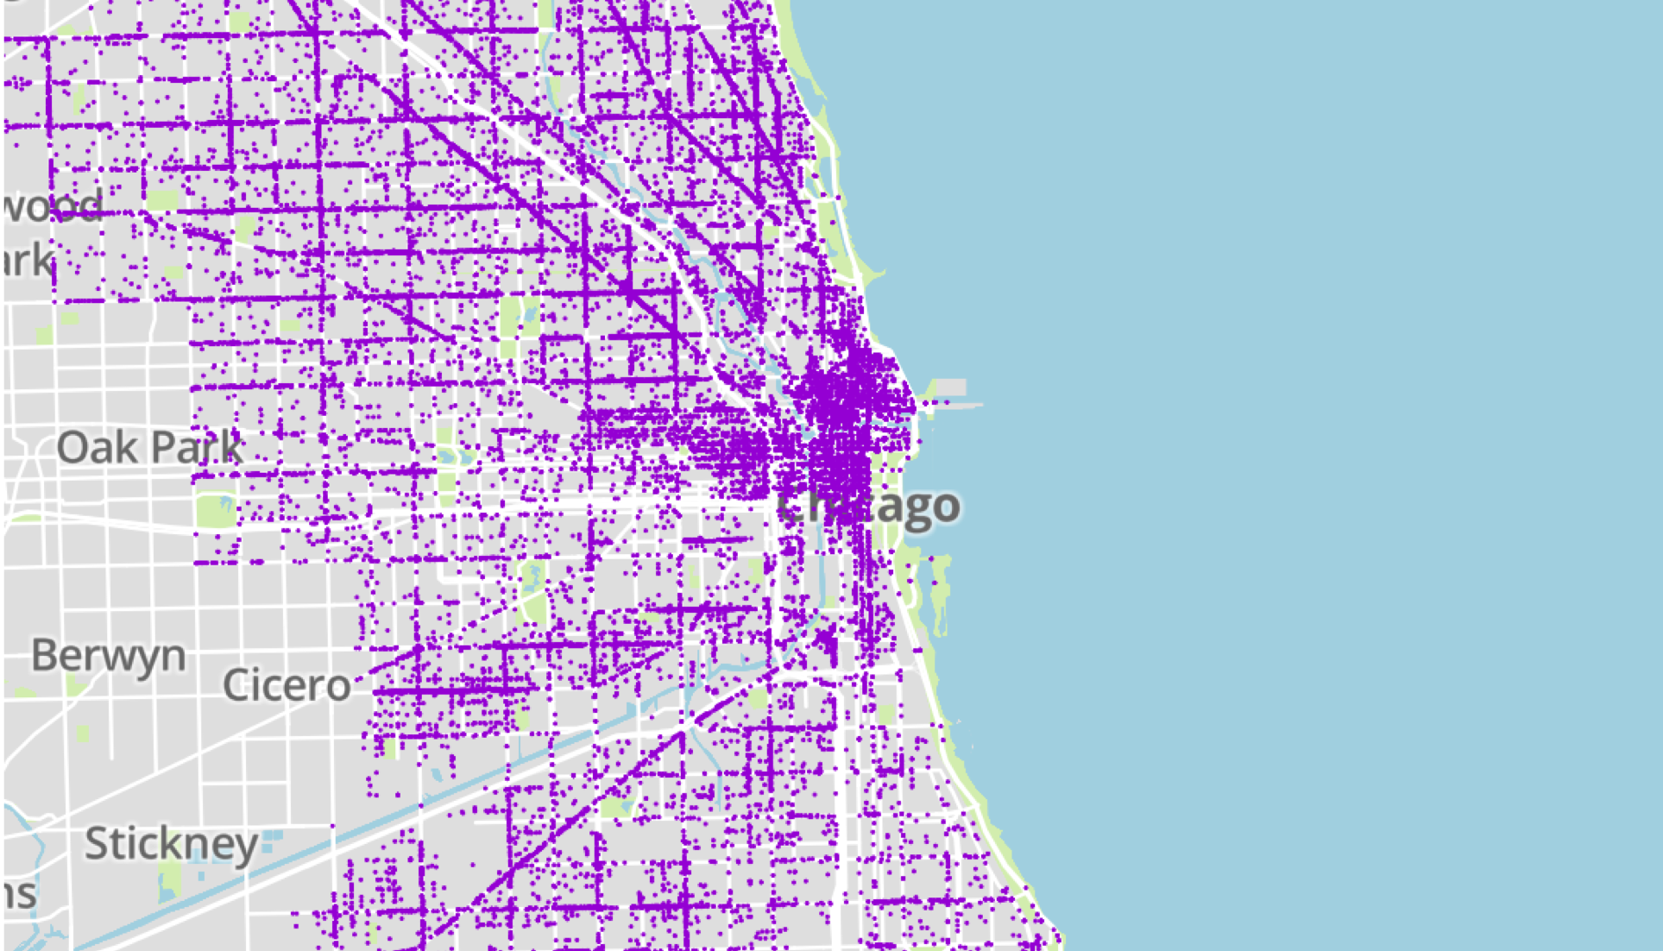
Registered Businesses
Registered Businesses
61,799
61,799
Notes:
So let’s start looking at the data I used to build my final model. I gathered a list of all CURRENTLY REGISTERED businesses from Chicago Data Portal, JUST UNDER 62,000 in total.

Slide 5
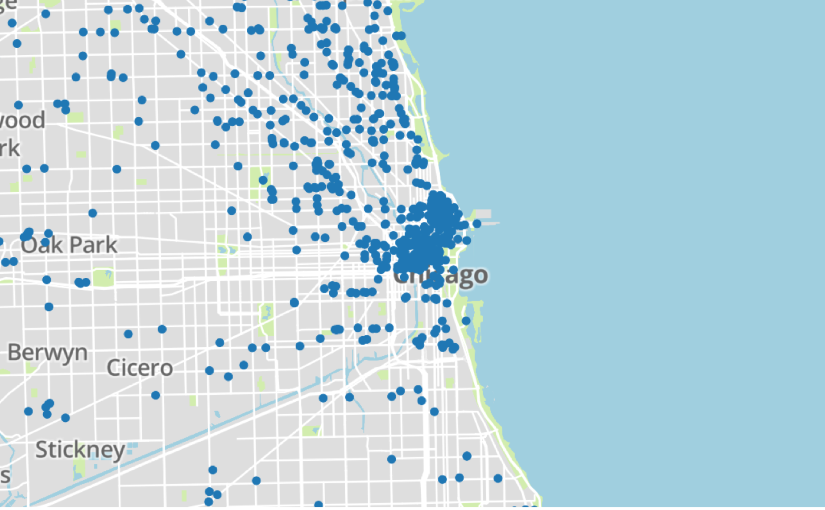
Coffee Shops from Yelp API
936
Notes:
I then used Yelp’s API to generate a list of just under a thousand coffee shops throughout the city,

Slide 6
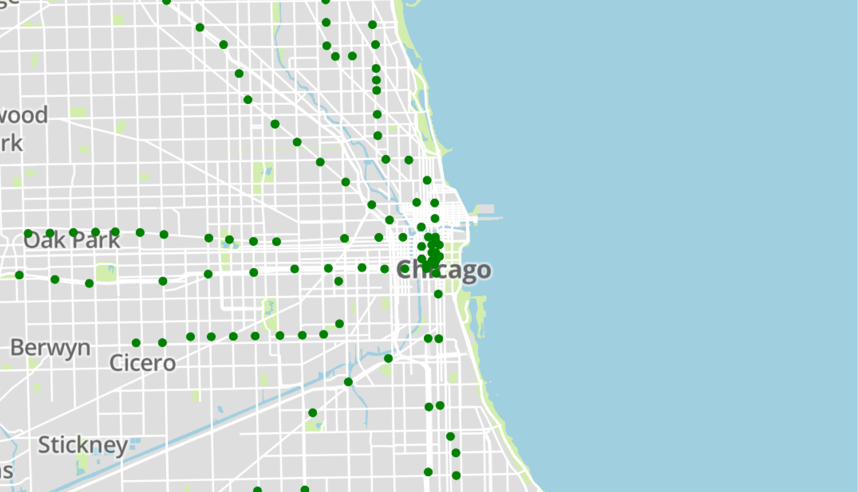
El Stops
149
Notes:
I then gathered data about El stops, 149 in total.

Slide 7
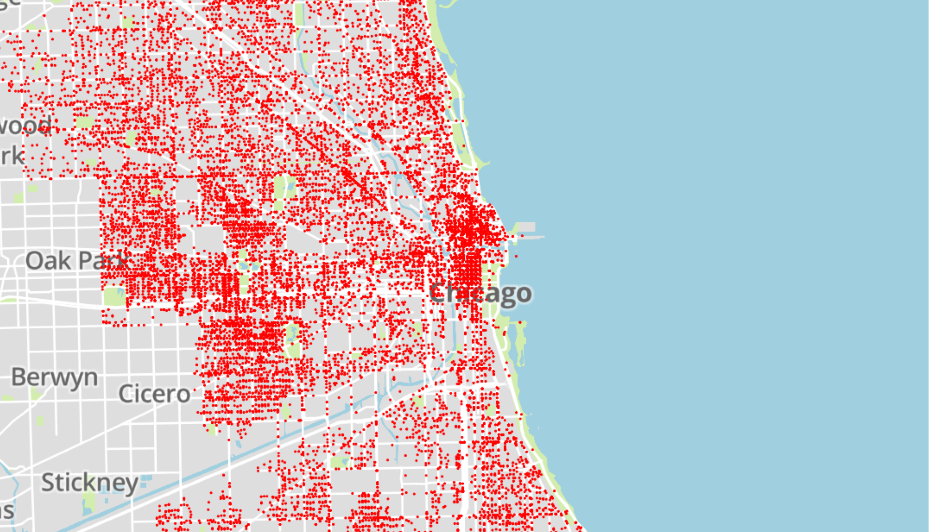
Crime
41,135
Notes:
and finally gathered crime data. Just under 42,000 recorded incidents in total in total.
Just to review, after testing out a variety of data features, I chose to focus on an area’s business density, proximity to competitors, proximity to public transport, and crime in my final model.
Because all of this data had precise latitude and longitude locations associated with it, I was able to convert it into data fit for machine learning.

Slide 8
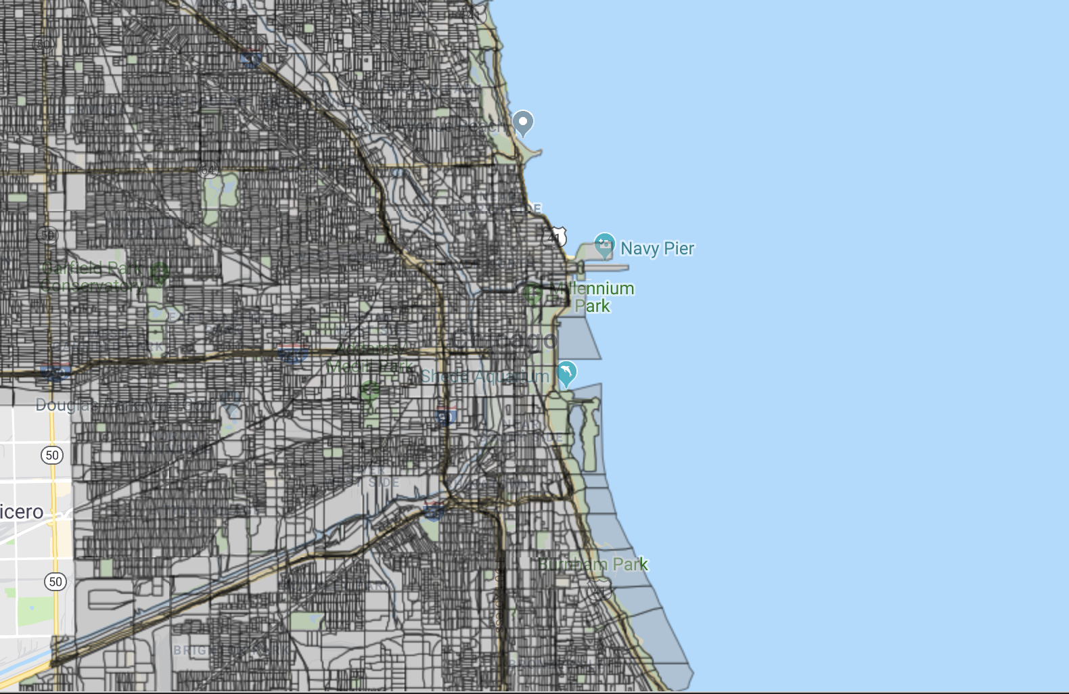
Census 2010 Blocks
46,357
Notes:
The census organizes its data by geographic area, the smallest unit of which is the block level. I found the latitude and longitude of the block centers, and mapped count and distance data onto each.

Slide 9
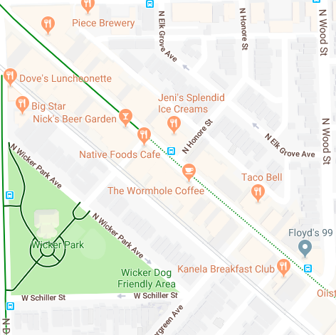
Counts within an Area
Counts within .001 total radians from centroid along Manhattan distance
1 coffee shop
.0005
9 businesses
3 crimes reported
.0005
40
Census Pop: 40
El
Distance to closest El .005
Notes:
I drew a small square around each center, such as this one near Wicker park. There’s Wormhole. Within this area, I counted coffee shops, businesses and crimes reported, calculated the distance to the el, and recorded the census population and distance to the el. In the end, I had a pandas dataframe of just over 46,000 rows each of which represented a city block.

Slide 10
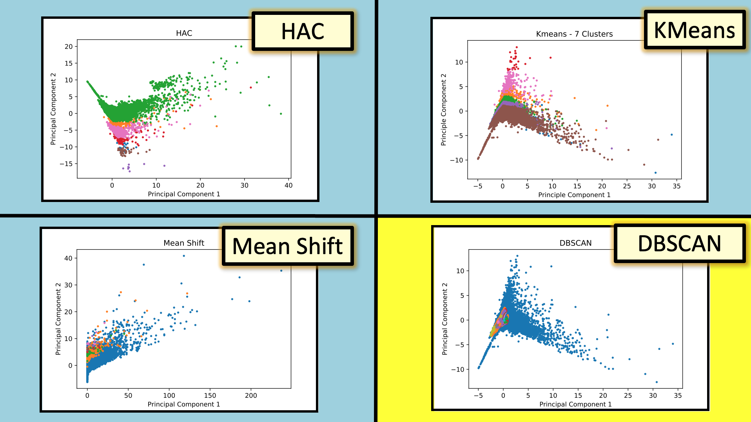
Notes:
Now the data was reading for machine learning. Clustering algorithms use distance metrics to find similarities between data points. I tried out a bunch, HAC, Kmeans, and MeanShift, before settling on DBSCAN as my clusterer of choice.

Slide 11
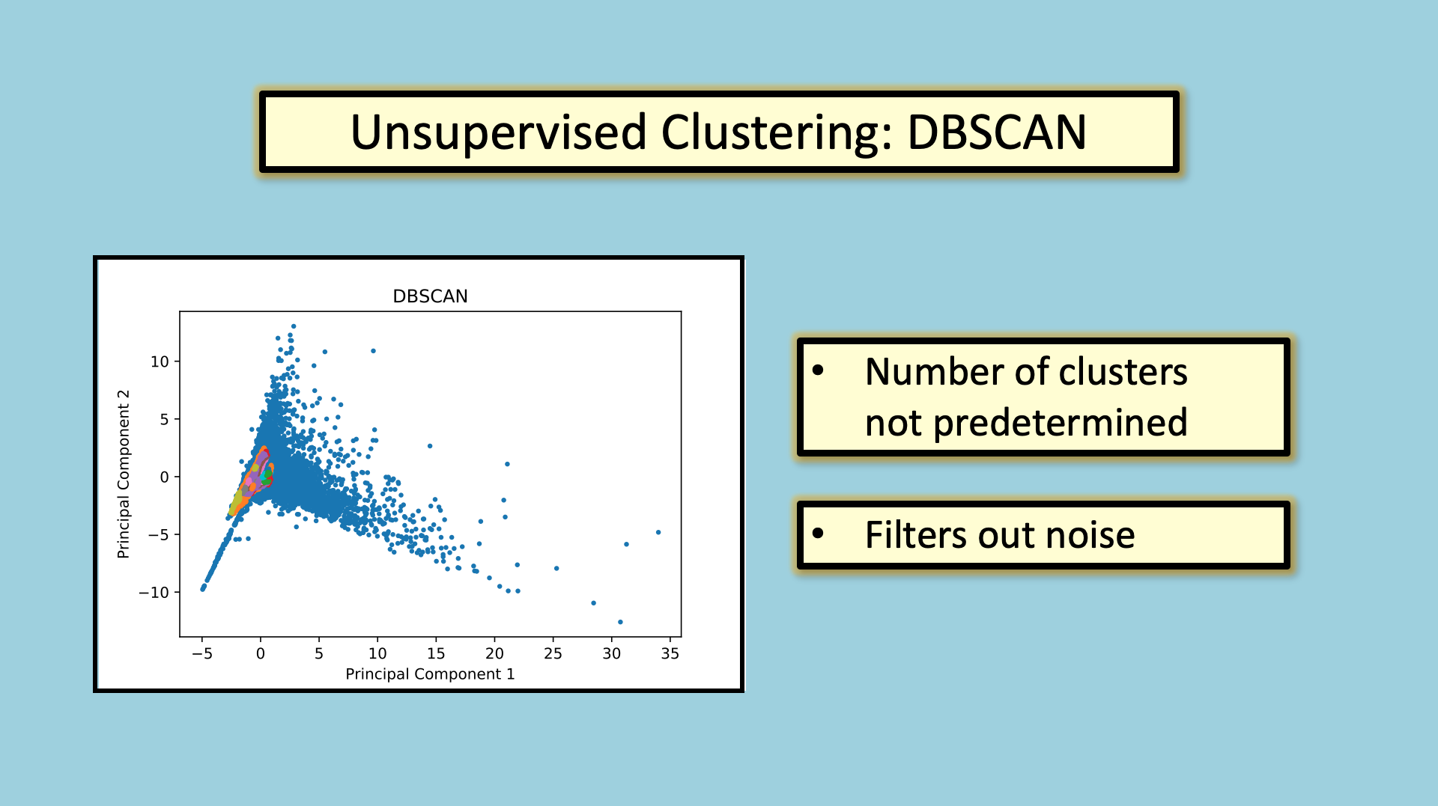
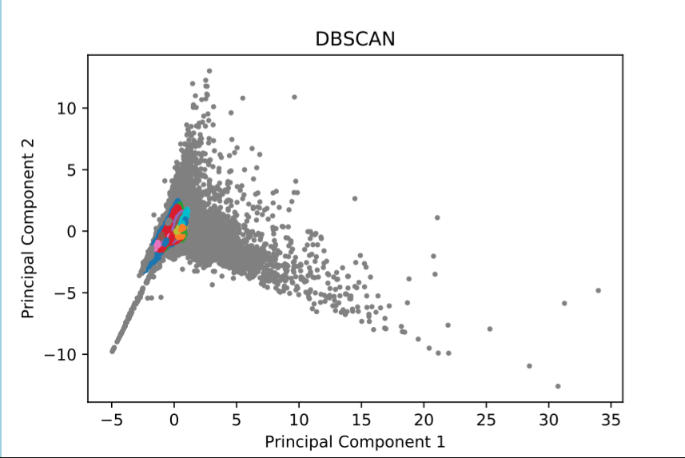
Notes:
There were two main reasons I DBSCAN. Firstly, it does not require a preset number of clusters, which fits well with the openendness of the question. Secondly, points that are not in the neighborhood of other points are not assigned to clusters and labeled noise. There are a lot of blocks in the city which wouldn’t be good for coffeeshops, so any help filtering those out was welcome.

Slide 12
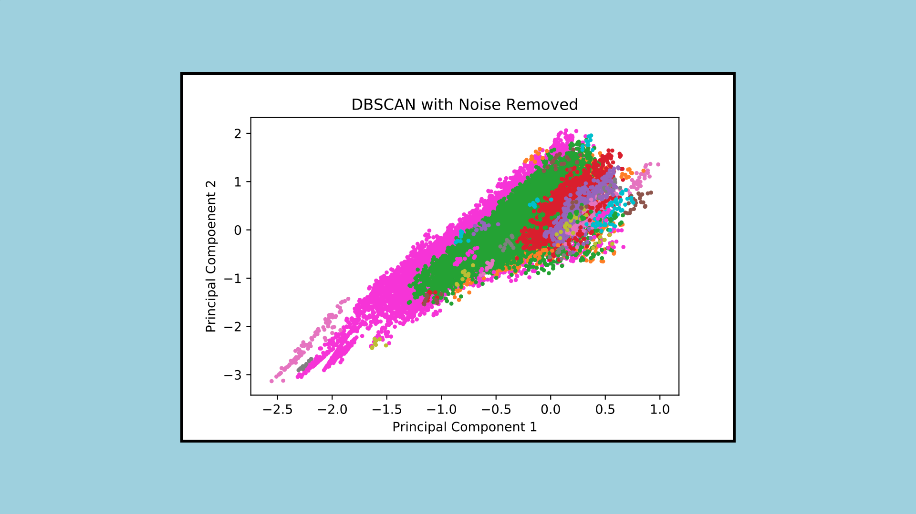
42 Clusters
Notes:
Removing the noise left me with the following clusters, 42 in total. From here, I was left to chisel away the clusters to narrow in on my preferred qualities.

Slide 13
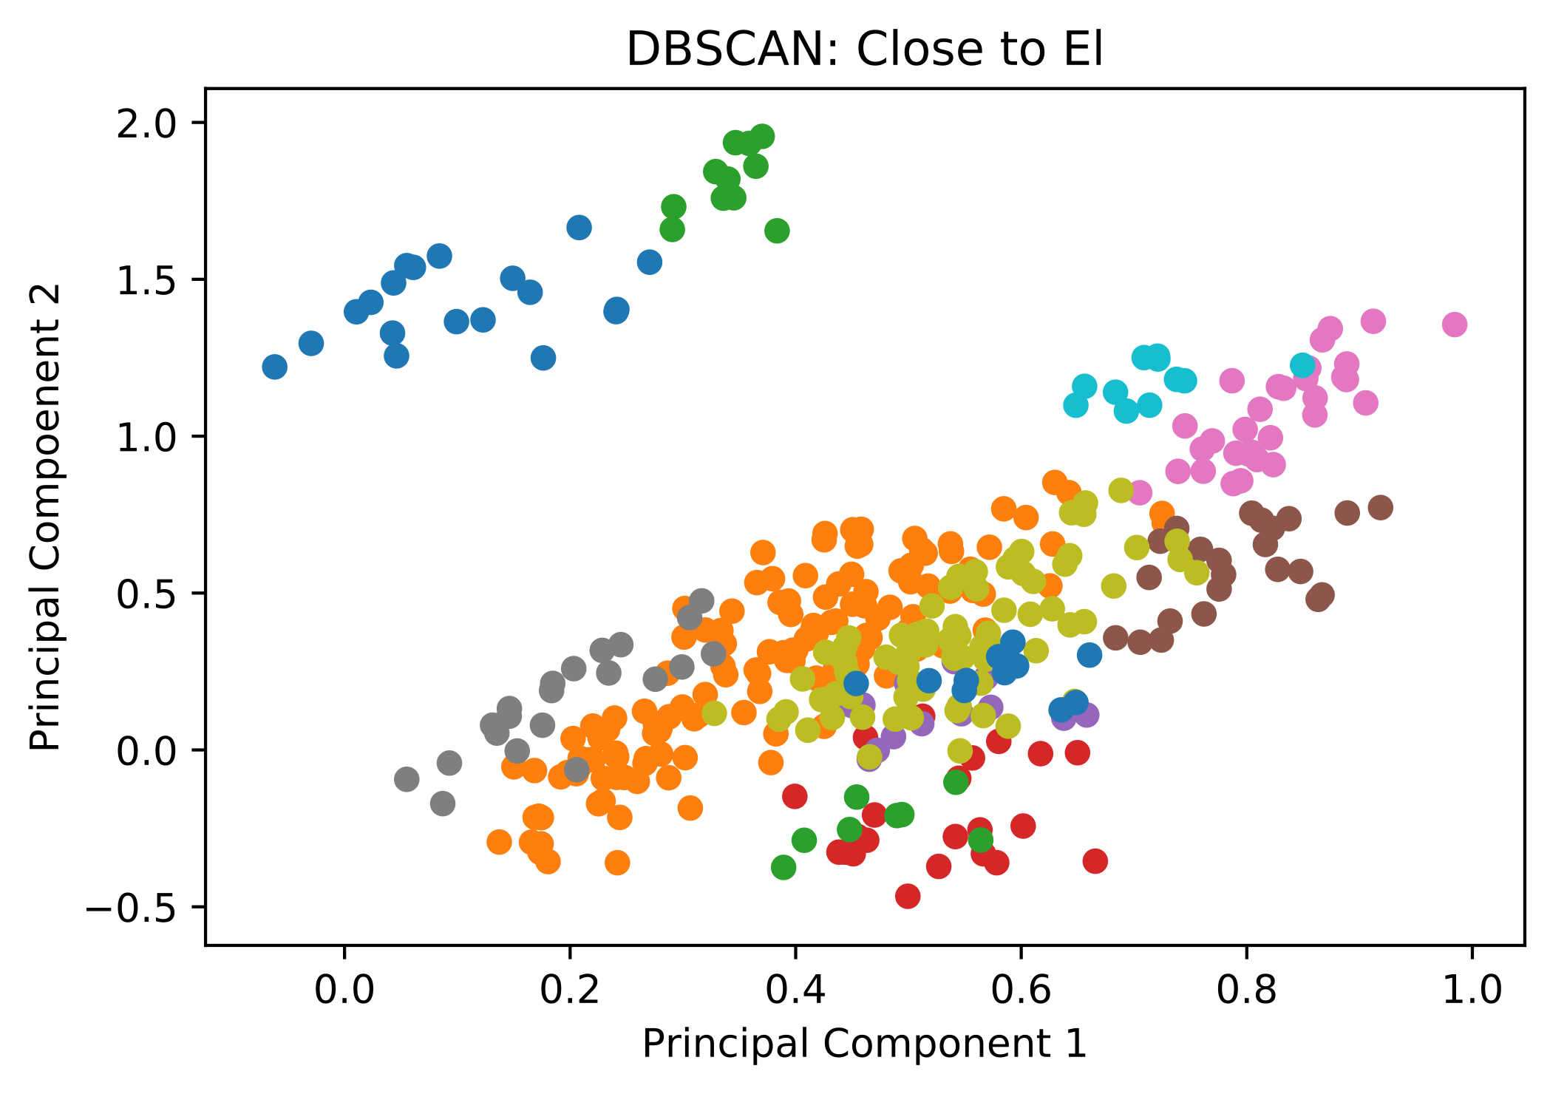
Remove Clusters Far from the El
13 Clusters
Notes:
By looking at means of the associated data points, I selected the clusters which were on average close to the El , leaving 13 clusters.

Slide 14
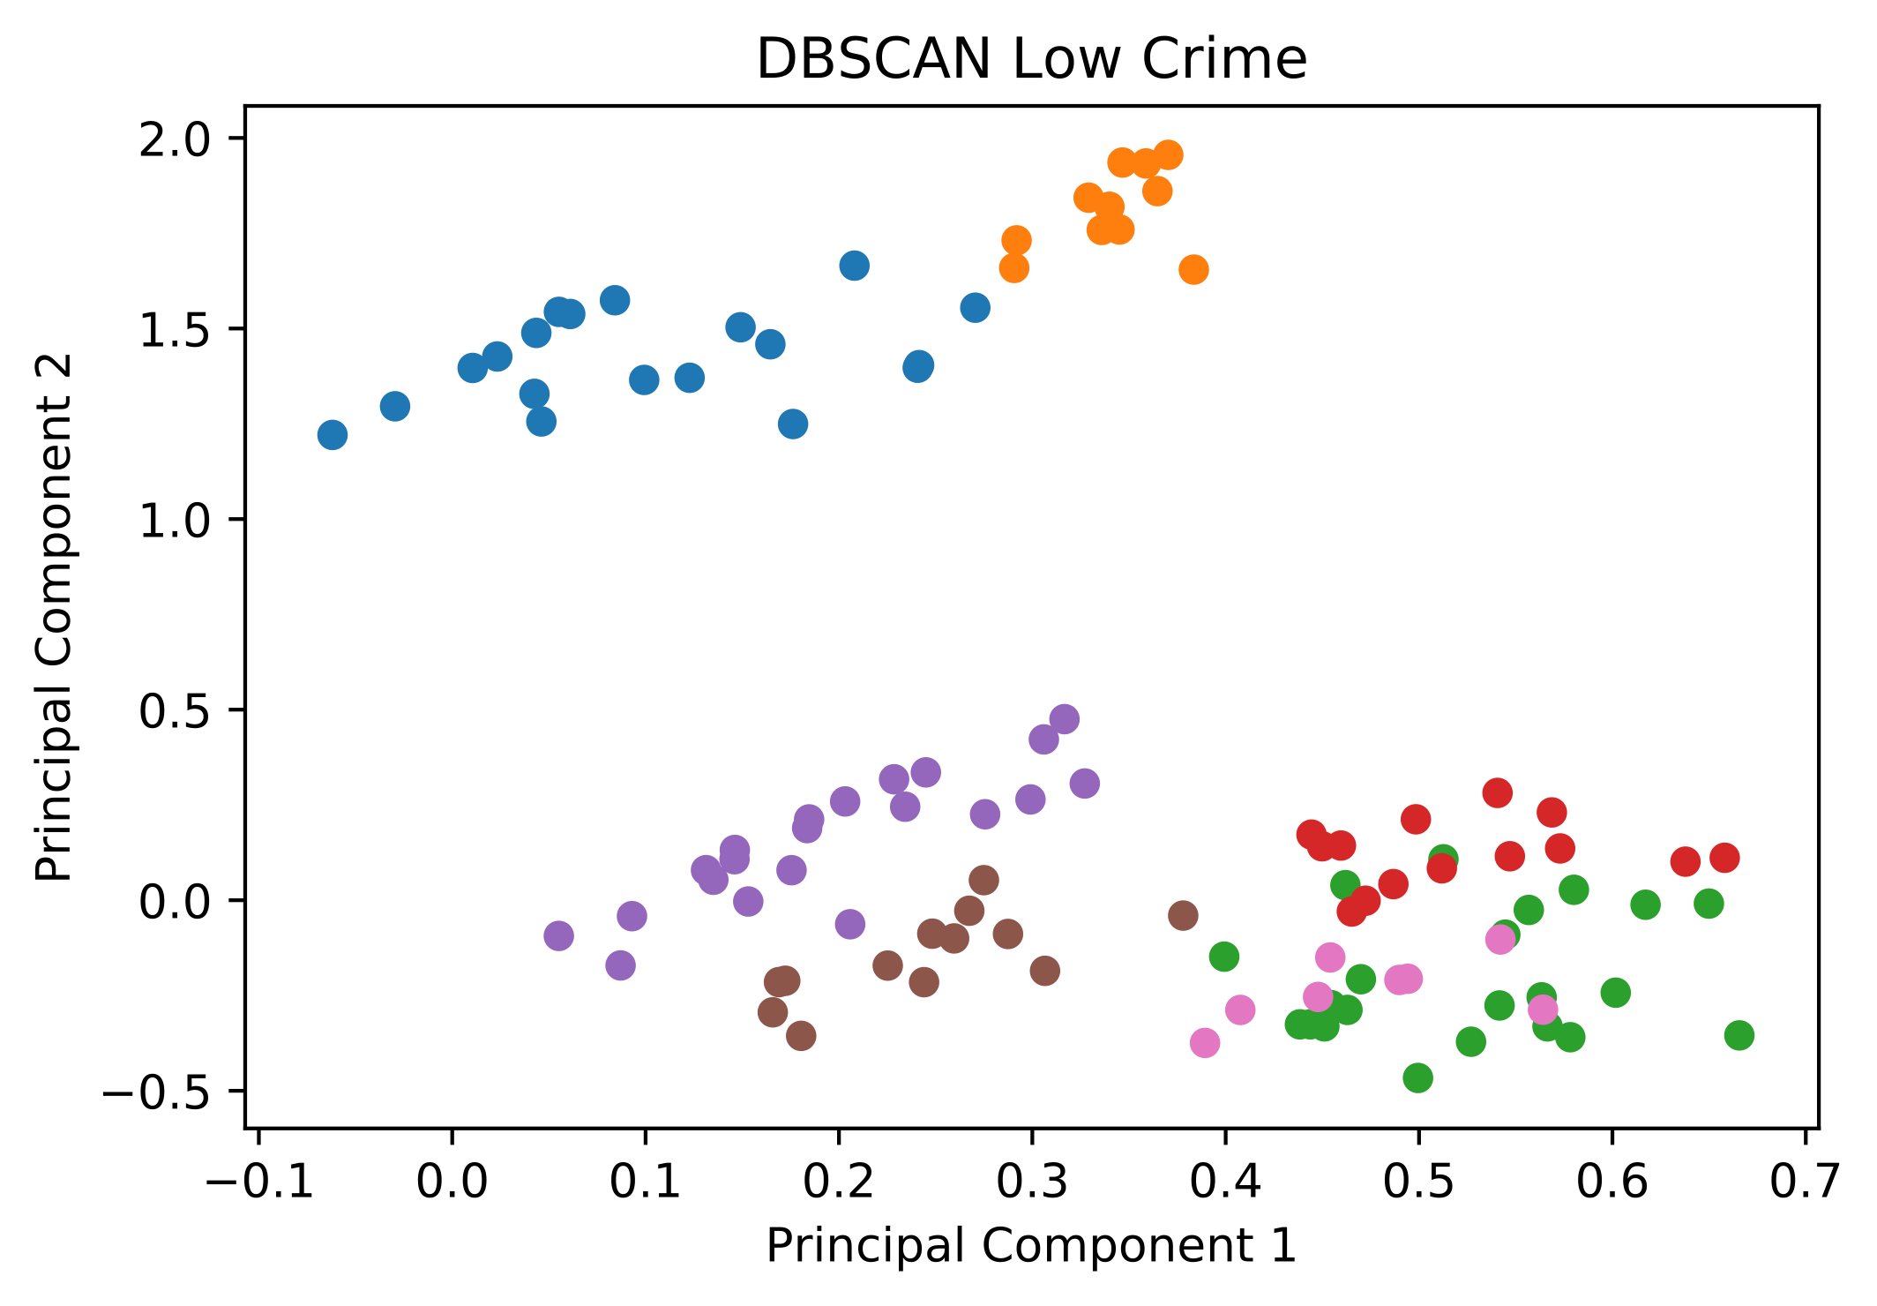
Remove Clusters with High Crime
7 Clusters
Notes:
Then I selected clusters with low crime, leaving 7.

Slide 15
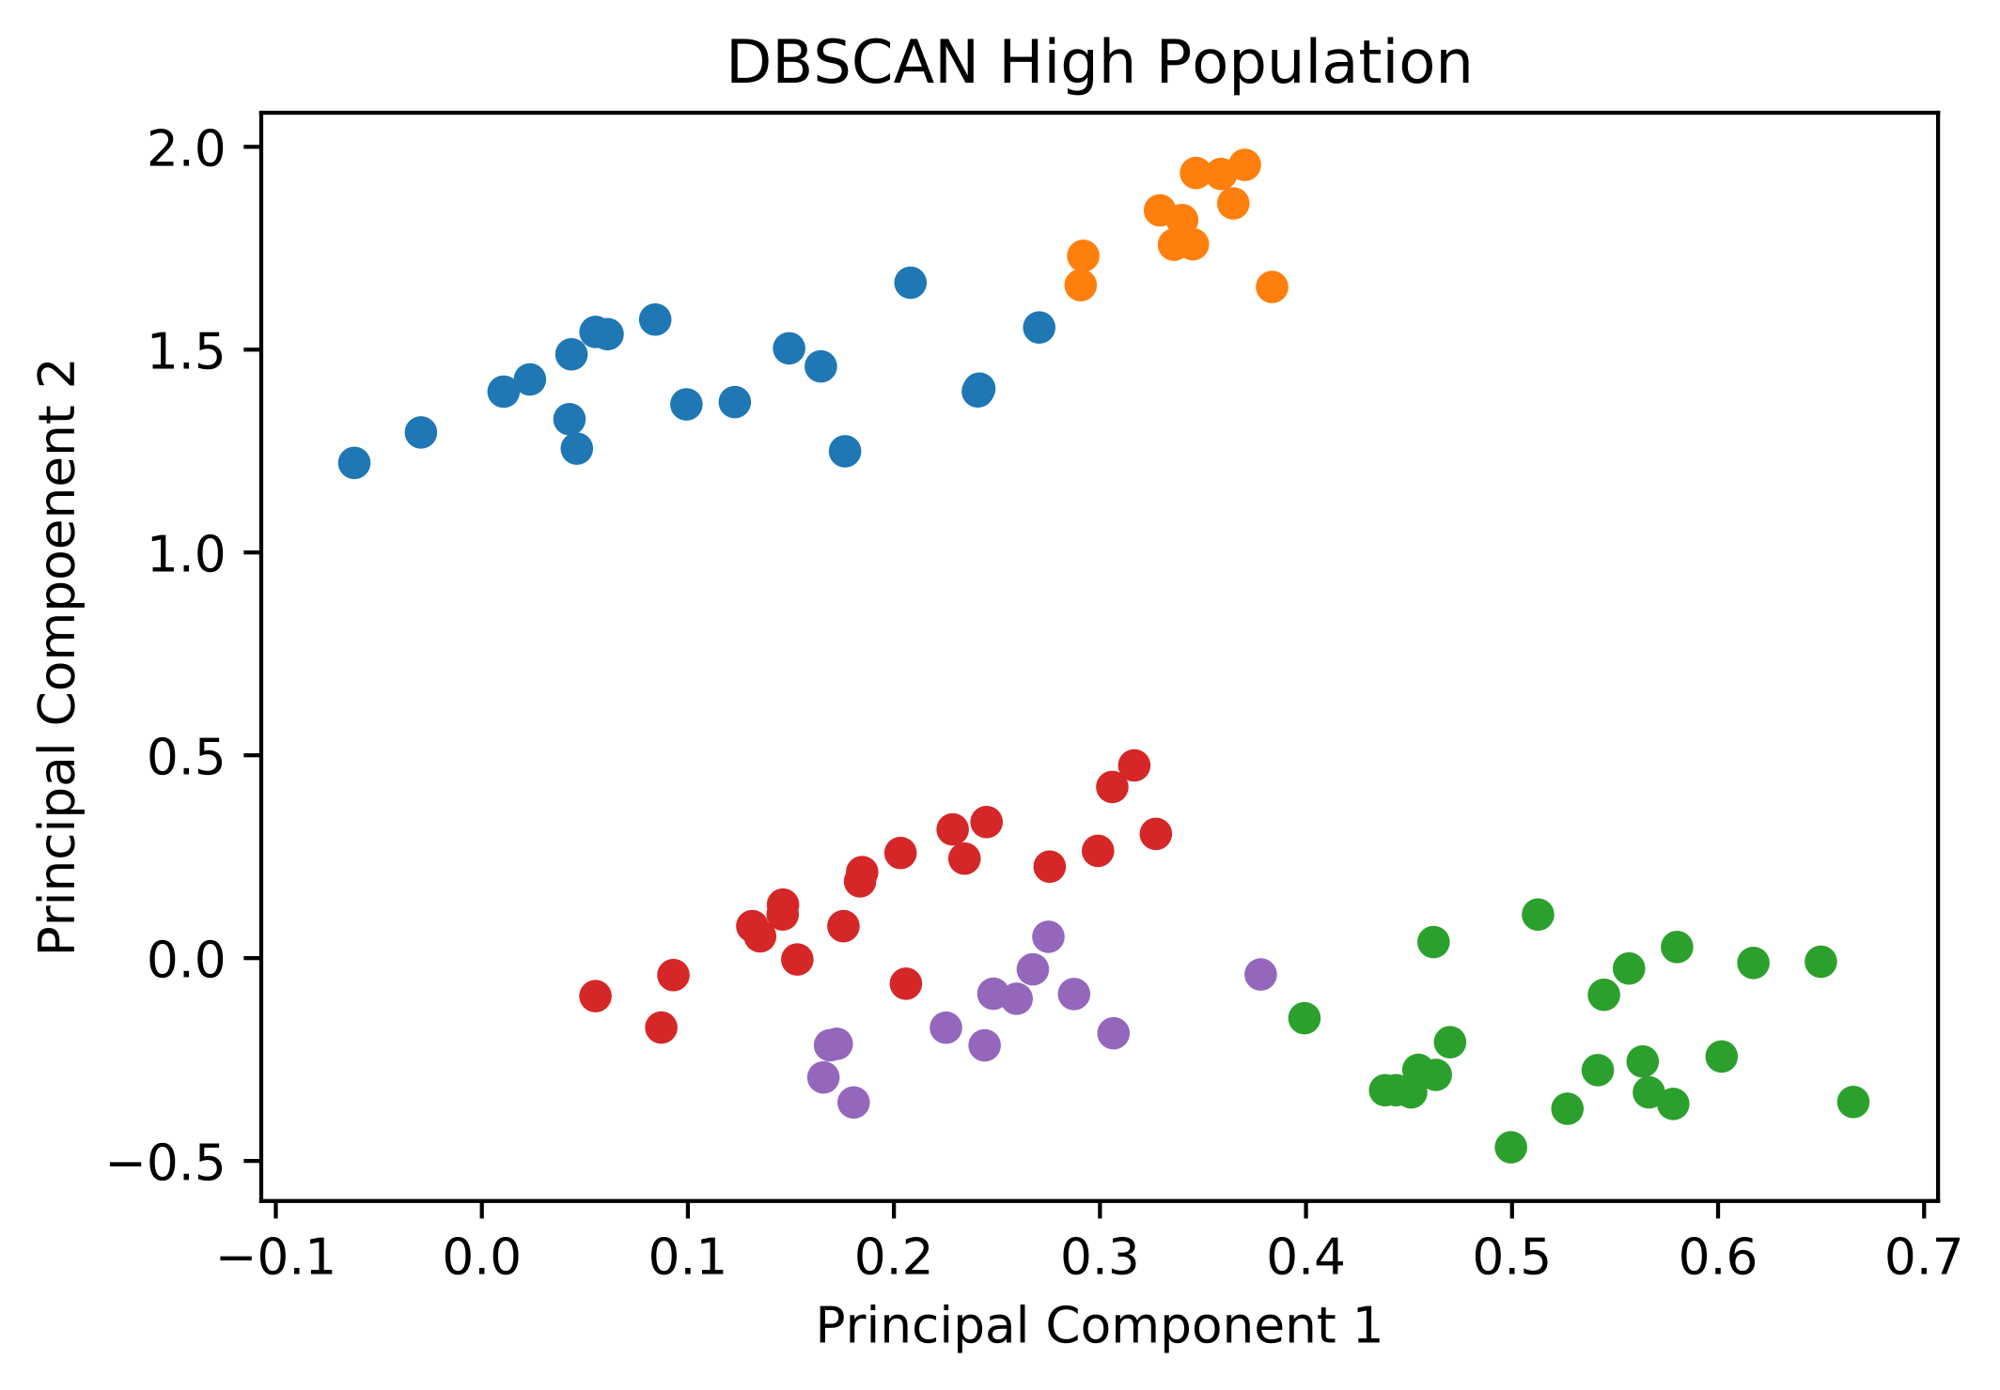
Remove Clusters with Low Population
5 Clusters
Notes:
Lastly, I selected clusters with high population, leaving 5 final clusters.

Slide 16
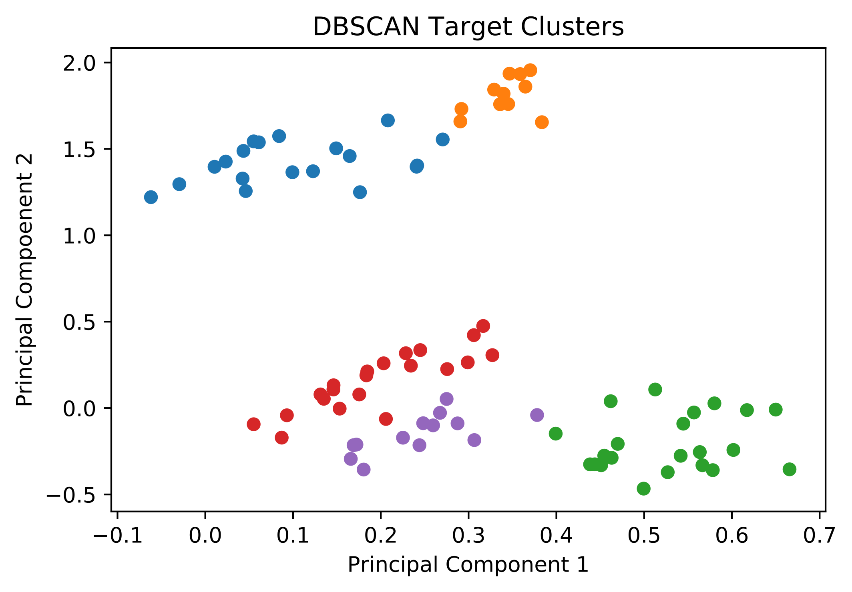
Target Clusters
Highest business,
lowest pop.
Highest pop., some business, closest to El
Very high pop., some business
High pop., some business
High pop., some business, highest crime
Notes:
This left me with the following target clusters with their distinguishing characteristics listed on the right.

Slide 17
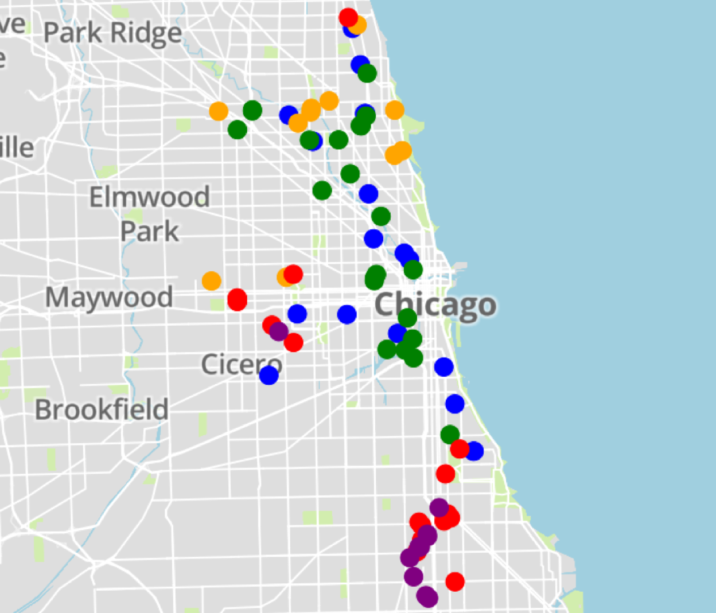
Blocks to Investigate
Highest business,
lowest pop., lowest crime
Highest pop., some business, closest to El
Very high pop., some business
High pop., some business, higher crime
High pop., some business, highest crime
Notes:
Here they are mapped on the city.

Slide 18
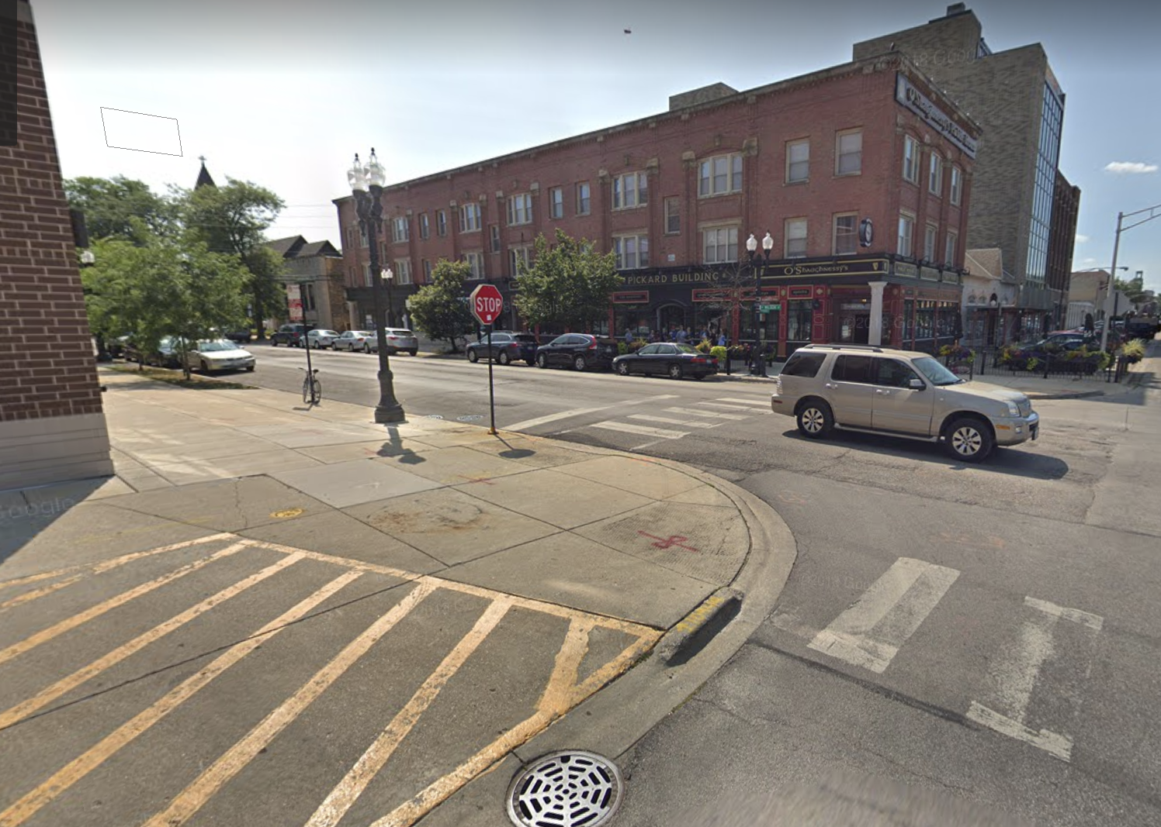
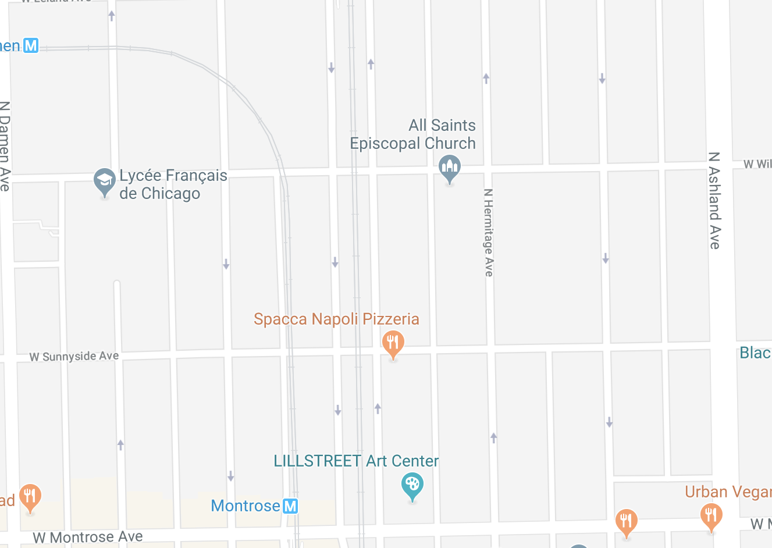
Coffee Shop
Location Recommendation
Notes:
The recommendations are pretty interesting. Here is one spot I particularly like in between the Montrose and Damen brown line.

Slide 19
General Business Applications
Selecting where to open a new office
Geographic and demographic customer insight
Targeted advertising
Visualizing and predicting growth patterns
Notes:
In general, this type of application can be used in a variety of ways. It can help one find a new office location, contribute to geographic and demographic customer insight, help with targeted advertising, and visualizing and predicting growth patterns.

Slide 20
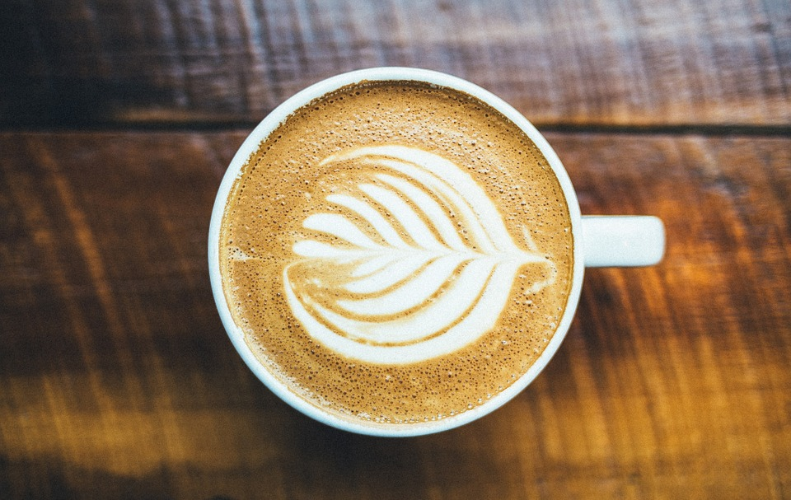




in/max-barry
github.com/j-max
Thank you
jmax.barry@gmail.com
Notes:
Picture/contact/github

